Slide 1
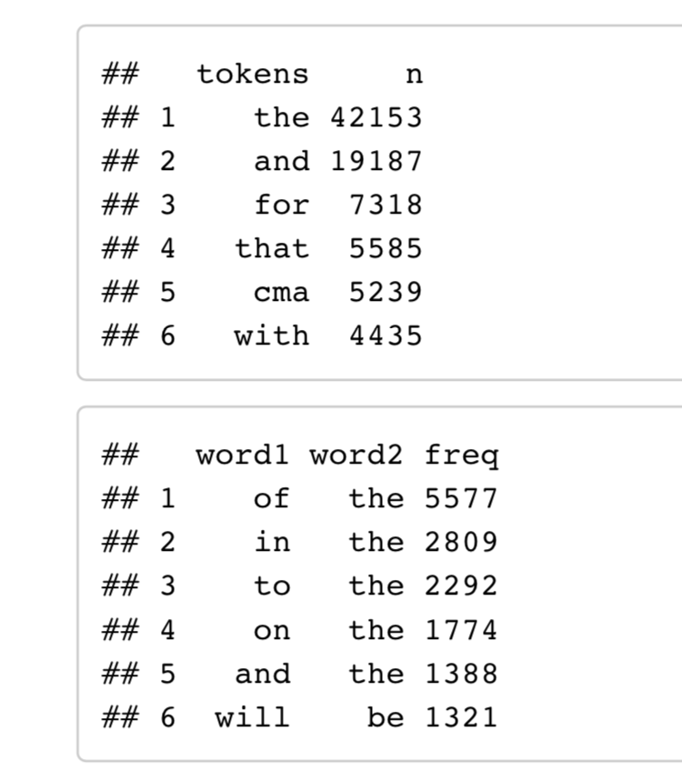
Word Counts and Bigram Counts
Took all words in the groundtruth papers and calculated word frequencies
Looked at the two neighboring words for each word and calculated bigram frequencies
The entire word list of all papers in groundtruth serves as our training data for this project and our ”dictionary” when we check for the existence of a word

Slide 2
Look for spelling differences between groundtruth and tesseract
Since the words in groundtruth and tesseract do not have 1:1 correspondence (word #20 in groundtruth will probably not exactly match up with word #20 in tesseract), we search through a given window of that index to find a match
For each word in tesseract, the algorithm searches through the given search window to lead to one of three results:
The word was spelled correctly (a word was found with the exact same spelling as the word in tesseract)
The word was misspelled (A word with a similar spelling was found)
No Match Found (the tesseract word was either so badly misspelled, or it was taken out of groundtruth)
The algorithm chooses only the words in scenario 2, so we can try to correct the spelling for these

Slide 3
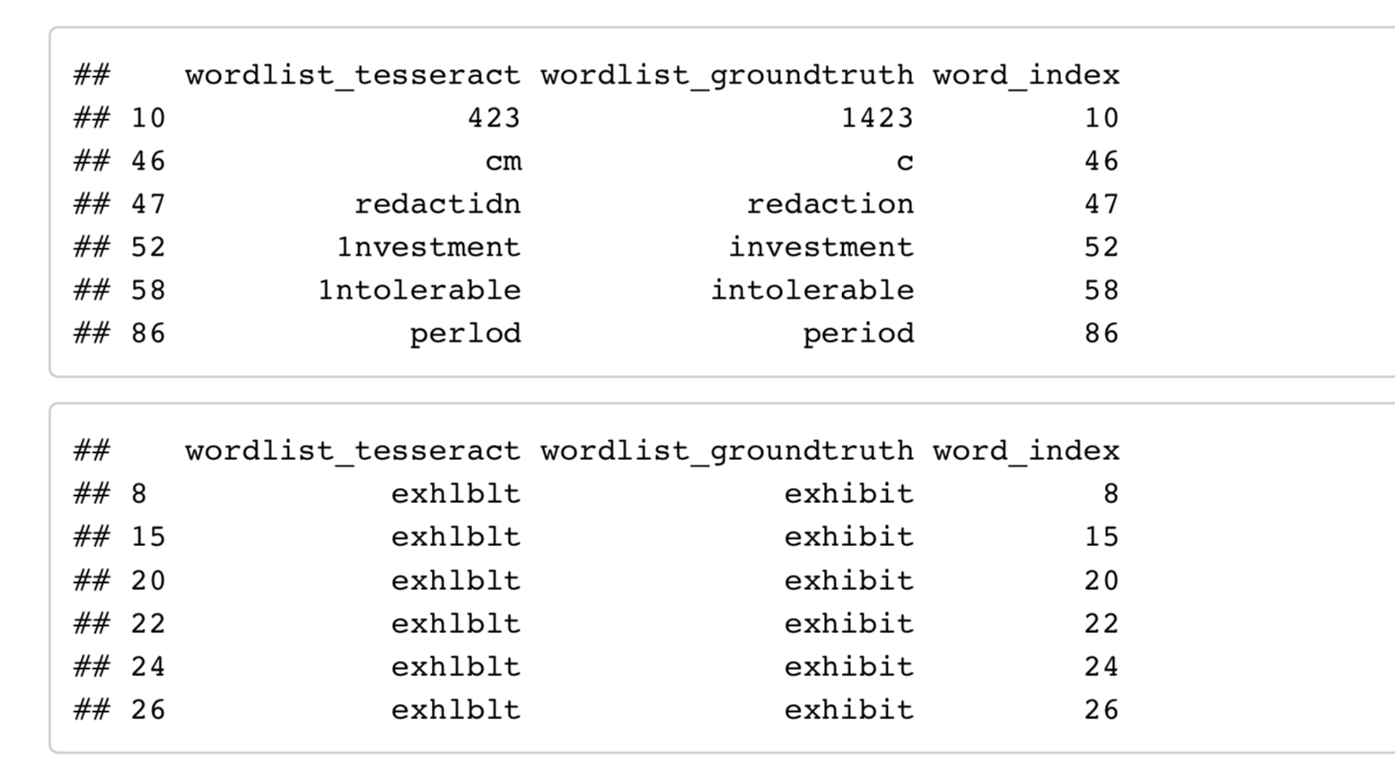
Look for spelling differences between groundtruth and tesseract (cont.)
We group these into 2 categories:
Misspelled words that are off by only one character (top)
All misspelled words (bottom)
Wordlist_tesseract is the misspelled word, wordlist_groundtruth is the correctly spelled match, and word_index is the location of the word

Slide 4
Correcting the Words
Take each misspelled word, and use the word index to find the left and right neighbors of that word, to provide bigram information
3 techniques to find a possible correct spelling:
Deletion: Sees if removing an unnecessary character from the word will create a correctly spelled word
Insertion: Sees if adding a missing character to a word will create a correctly spelled word
Substitution: Sees if replacing a character with a different character will create a correctly spelled word
These techniques only work for words off by one character
If there are multiple potential corrections that come from these three techniques, the one with the highest word frequency and bigram frequencies (with the left and right neighbors) is chosen

Slide 5
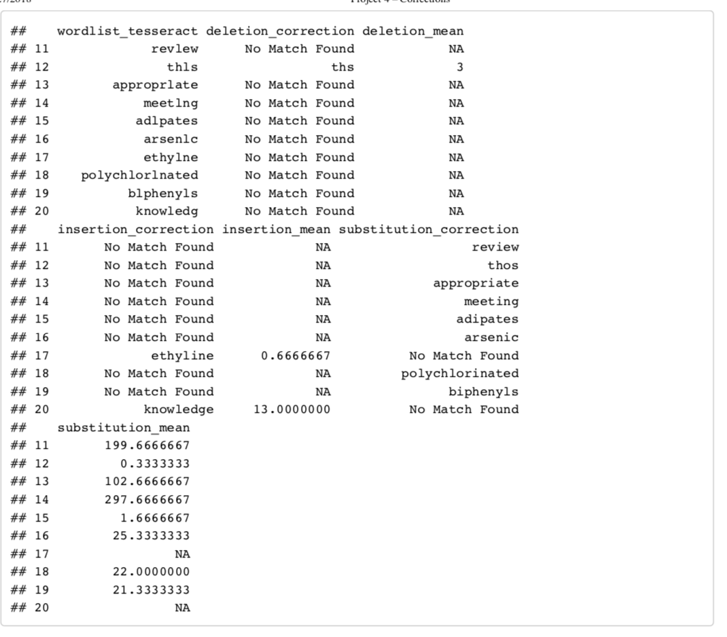
Best deletion, insertion, and substitution corrections for words off by one character
Deletion mean, insertion mean, and substitution mean are the means of the word’s frequency and bigram frequency, and this is how we “score” the correction

Slide 6
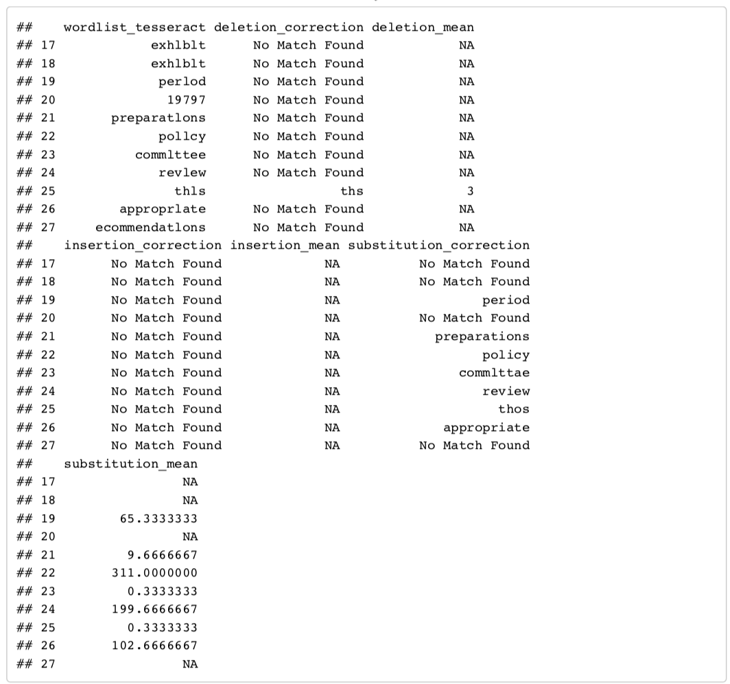
Best deletion, insertion, and substitution corrections for all mistakes
You can see here that many of the words do not have a match, since the techniques do not work for words that are off by more than one character.

Slide 7
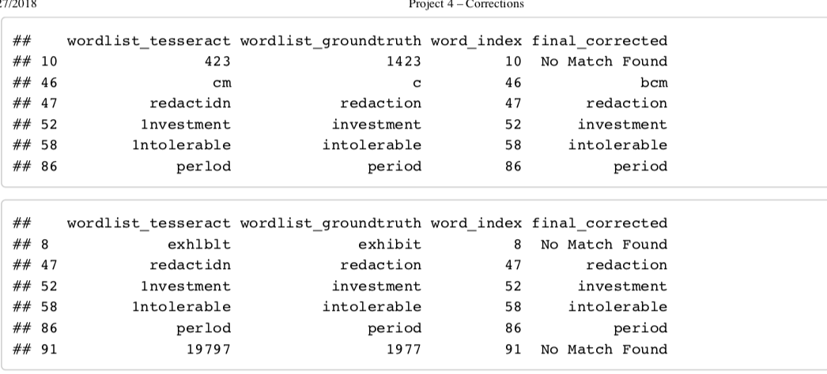
Choosing the final best word and testing the accuracy
Use the deletion mean, insertion mean, and substitution mean for each word to find which correction is the most likely
Compare these corrections to the groundtruth spellings
Attempted to correct the first two papers in group 1
For the words that were only off by one character: 72% accuracy
For all misspellings: 64% accuracy.
Misspelled word, correct word, word location, and correction attempt, for words off by one character (top) and all mistakes (bottom)

